Slide 1
Project Report on LAI estimation of Wheat using empirical and ML Algorithms
M.Sc Agriculture Analytics
Submitted To:
Dr. N.R.Patel [Scientist – ASD]
Ms. Shweta Pokhriyal [JRF - ASD]
Agriculture and soil department, IIRS-ISRO.
Submitted by:
Harshilkumar Ponkiya
Nidhi Gusai

Slide 2
Content
Study Area
Objectives
Materials and methods
Results
Conclusion
References

Slide 3
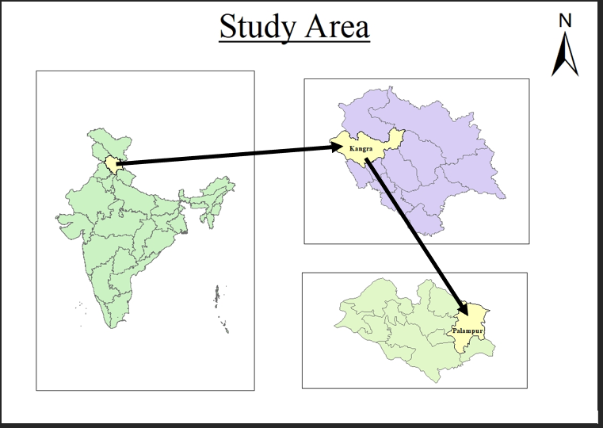
This study aimed to estimate the Leaf Area Index (LAI) of wheat crops in the Palampur Subdistrict of Kangra District, Himachal Pradesh, using various machine learning algorithms.

Slide 4
Objectives
To Investigate the relationship between different vegetation indices and leaf area index for wheat-crop in Palampur, Himachal Pradesh.
To develop machine learning models for LAI estimation.

Slide 5
Process flow-chart
Data Collection (Sentinel-2 Harmonized)
LAI-Vegetation Indices Correlation Analysis
Vegetation indices Computation
Data Preparation
LAI Mapping
Comparing machine learning models
Model Evaluation and validation
ML Model Development

Slide 6
Data collection
This study has ground data for wheat in the Palampur subdistrict of Kangra district of Himachal Pradesh from 5th January 2023 to 15th January 2023.
We utilized ground truth points of LAI with geographic locations to determine LAI values using various indices.
The vegetation indices are downloaded from the Sentinel-2 satellite imagery in the Google Earth Engine platform.
The vegetation indices included NDVI, EVI, GNDVI, CI, SAVI and NDRE, commonly used in LAI estimation studies.

Slide 7
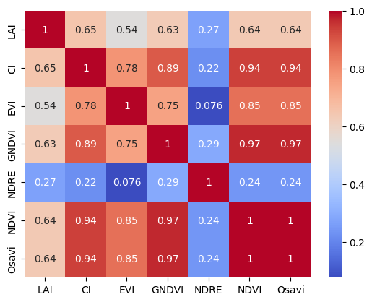
Correlation Analysis
Correlation analysis is a useful statistical technique for exploring the relationships between variables in agriculture research.
It can help identify significant associations between LAI and Vegetation indices, providing valuable insights for crop management and decision-making.
This chart represents the strong correlation between LAI and major vegetation indices. The presented data indicates that these indices are highly indicative of LAI.

Slide 8
ML Model Development
In this study, we estimated LAI in wheat-crop using different ML algorithms. Among these algorithms are:
Multiple Linear Regression
Random Forest Regression
Support Vector Machines Regression
Gradient Boosting Regression
Extreme Gradient Boosting(XGBoost)

Slide 9
Results
Sr. No. | Model | RMSE | R² Score | Index of Agreement
1 | Multiple Linear regression | 0.3934 | 0.6874 | 0.8782
2 | Random forest regressor | 0.3934 | 0.6047 | 0.8500
3 | SVM regressor | 0.4629 | 0.5672 | 0.7963
4 | Gradient boosting regression | 0.5431 | 0.4041 | 0.8118
5 | XGBoost regressor | 0.4417 | 0.6058 | 0.8524
Among these models, Multiple Linear Regression exhibited the lowest RMSE of 0.3934, indicating its relatively accurate predictions. Additionally, it achieved a high R² Score of 0.6874, signifying a moderate correlation between predicted and actual values.

Slide 10
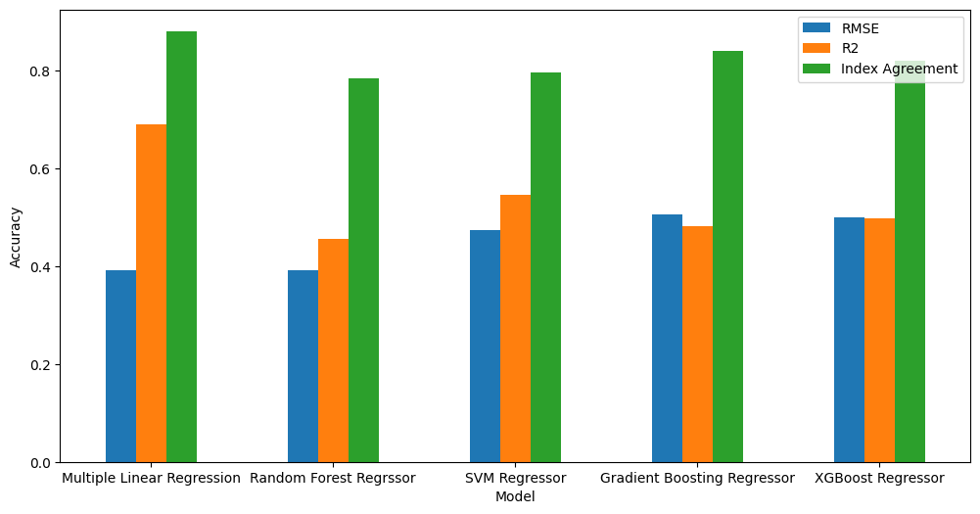
Results
The Index of Agreement for Multiple Linear Regression was also notably high at 0.8782, demonstrating a high level of agreement between predicted and observed values.
Random Forest Regressor and XGBoost Regressor also performed competitively across these metrics, while SVM Regressor and Gradient Boosting Regressor showed slightly lower performance

Slide 11
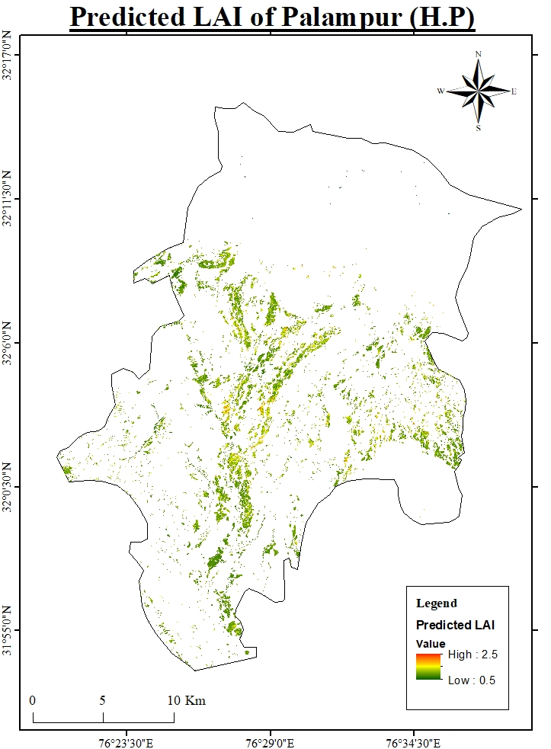
This map provides a visual representation of the leaf area index (LAI) values for wheat-crop in Palampur during January 2023.
The LAI values are an important indicator of the crop's growth and productivity, and this map can assist in analyzing and predicting the crop's potential yield.

Slide 12
Conclusions…
The study's findings highlight the effectiveness of multiple linear regression (MLR) in conjunction with key vegetation indices - namely NDVI, CI, OSAVI, EVI, and GNDVI, in accurately estimating LAI.
The high index of agreement (0.8782) for MLR underscores its robustness in agreement between predicted and observed LAI values, indicating its potential for practical implementation in crop management decision-making processes.
In essence, this study contributes to the growing body of knowledge surrounding remote sensing applications in agriculture, highlighting the potential of machine learning algorithms and vegetation indices in improving crop management strategies for enhanced agricultural sustainability and productivity.

Slide 13
References…
Srinet, ritika & nandy, subrata & N R patel. (2019). Estimating leaf area index and light extinction coefficient using random forest regression algorithm in a tropical moist deciduous forest, india. Ecological informatics. 52. 10.1016/j.Ecoinf.2019.05.008.
Dong, taifeng & liu, jiangui & shang, jiali & qian, budong & ma, baoluo & kovacs, john & walters, dan & jiao, xianfeng & geng, xiaoyuan & shi, yichao. (2018). Assessment of red-edge vegetation indices for crop leaf area index estimation. Remote sensing of environment. 222. 133-143. 10.1016/j.Rse.2018.12.032.
Jonckheere, inge & fleck, stefan & nackaerts, kris & muys, bart & coppin, pol & weiss, marie & frederic, baret. (2003). Methods for leaf area index determination. Part I: theories, techniques, and instruments. Agricultural and forest meteorology. 121.
Code link:
- https://colab.research.google.com/drive/1x222v7nziHJ_KiggJcGSXHF2CGZr0-Vk?usp=sharing
- https://colab.research.google.com/drive/1KqWuYd3gfRCmvA4vcXiMdbaR_Vh4gvkP#scrollTo=SA0u7XrERzup

Slide 14

Thank You
202319002@daiict.ac.in
202319015@daiict.ac.in​

